Slide 1
AI Racing League
Brennan Neuser, Jonathan Olaleye, Justin Pederson, Connor Preston, Sam Rose, Cameron Wolf
Advisors: Dan McCreary, Sachin Sapatnekar
Notes:
Justin

Slide 2
Agenda
The AI Racing League & Donkey Car
Customer Requirements
Car Setup
Training & Autopilot
Curriculum
Acceptance Test
Notes:
Justin

Slide 3
AI Racing League
Mission: “Promoting equity and innovation in AI education”
Aims to enhance AI and computer science skills and interest among Minnesota high schools and businesses.
Participants manually pilot a Donkey Car on a track to gather data, which is then used to train a model for the vehicle enabling autonomous navigation.
Currently implemented in several schools with an ongoing development of the curriculum.
Notes:
Justin

Slide 4
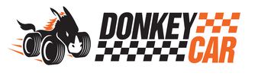
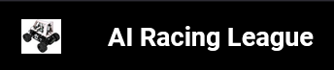
Donkey Car
Donkey: “a self driving car platform for hobby remote control cars.”
Designed for educational purposes in AI and computer vision
Supports both remote-controlled (RC) and autonomous operation
Documentation is targeted at programmers, those with technical experience
The AI Racing League aims to fill in knowledge gaps and bring Donkey Car to a high school audience.
2024 Curriculum
Notes:
Justin

Slide 5
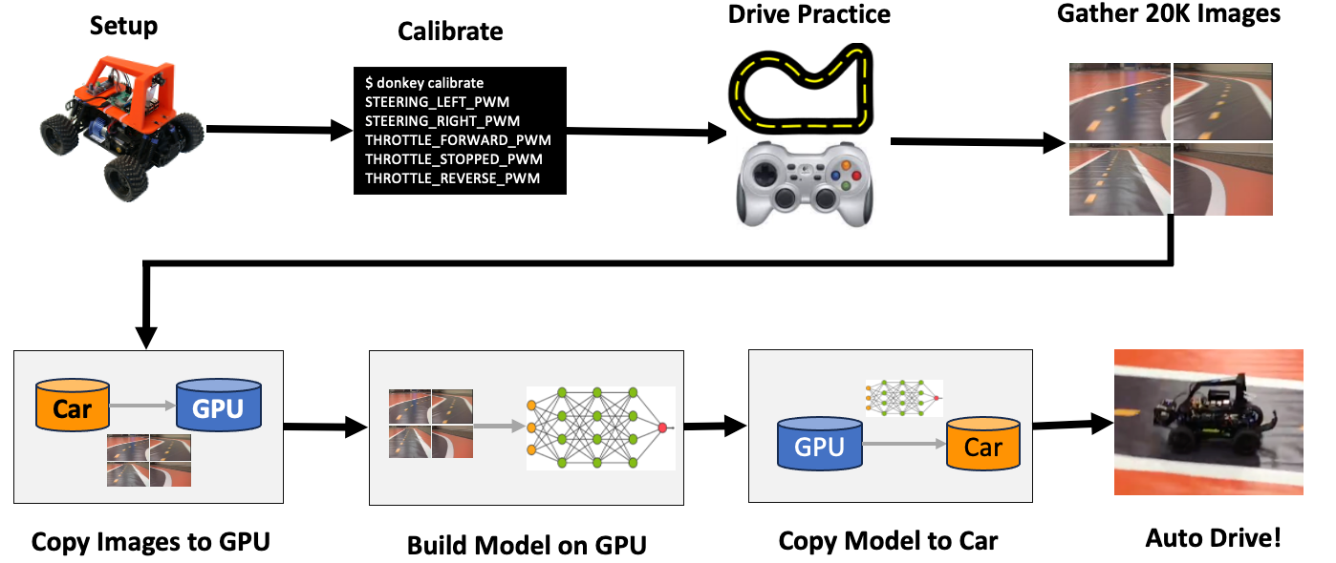
Donkey Car cont.
Notes:
Sam

Slide 6
Customer Requirements
Goal 1: Train a Donkey Car autopilot to autonomously navigate a track
Configure Donkey Cars to capture track data.
Use Donkey Cars for data collection during track navigation.
Incorporate collected data into a machine learning model to construct an AI agent.
Acceptance Criteria:
The car can complete several laps within track limits fully autonomously.
Notes:
Sam

Slide 7
Customer Requirements cont.
Goal 2: Create a comprehensive curriculum guiding high school students to set up a Donkey Car and train an AI autopilot
Impact:
Improve students’ accessibility to learning about AI through comprehensive curriculum and an affordable platform.
Acceptance Criteria:
Thorough documentation at an appropriate technical level for high school students that is easily accessible and comprehensive.
Notes:
Sam

Slide 8
Car Setup
Donkey Cars equipped with a Raspberry Pi 4 Model B
Past projects have used an NVIDIA Nano or Pi 3
Goal was to modernize AI Racing League documentation for the 4B and prepare for Pi 5
Raspberry Pi OS Bookworm installed via RPi Imager
donkeycar Python project provides calibration, driving, and training environment
Interface with Raspberry Pi over SSH
via Ethernet or WiFi
No keyboard/mouse/monitor required
Pi hosts a web server while driving – live camera feed and controls
Notes:
Jonathan

Slide 9
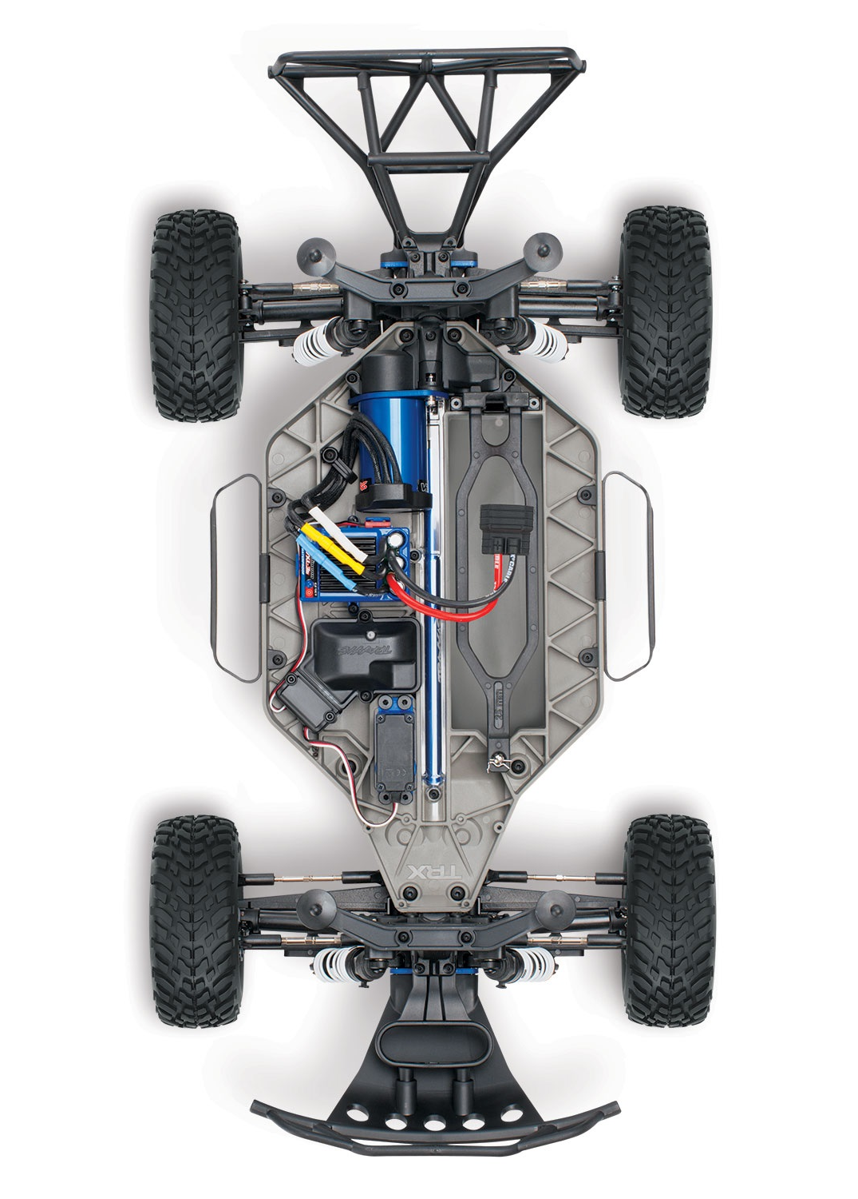
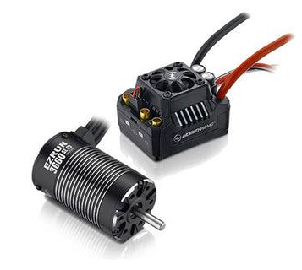
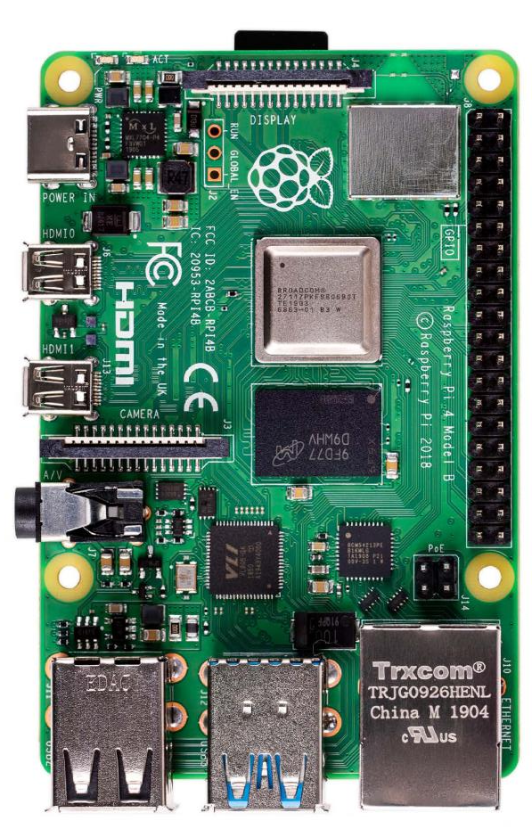
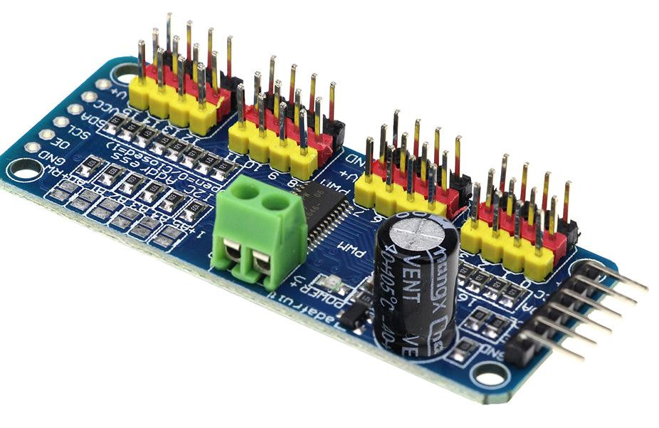
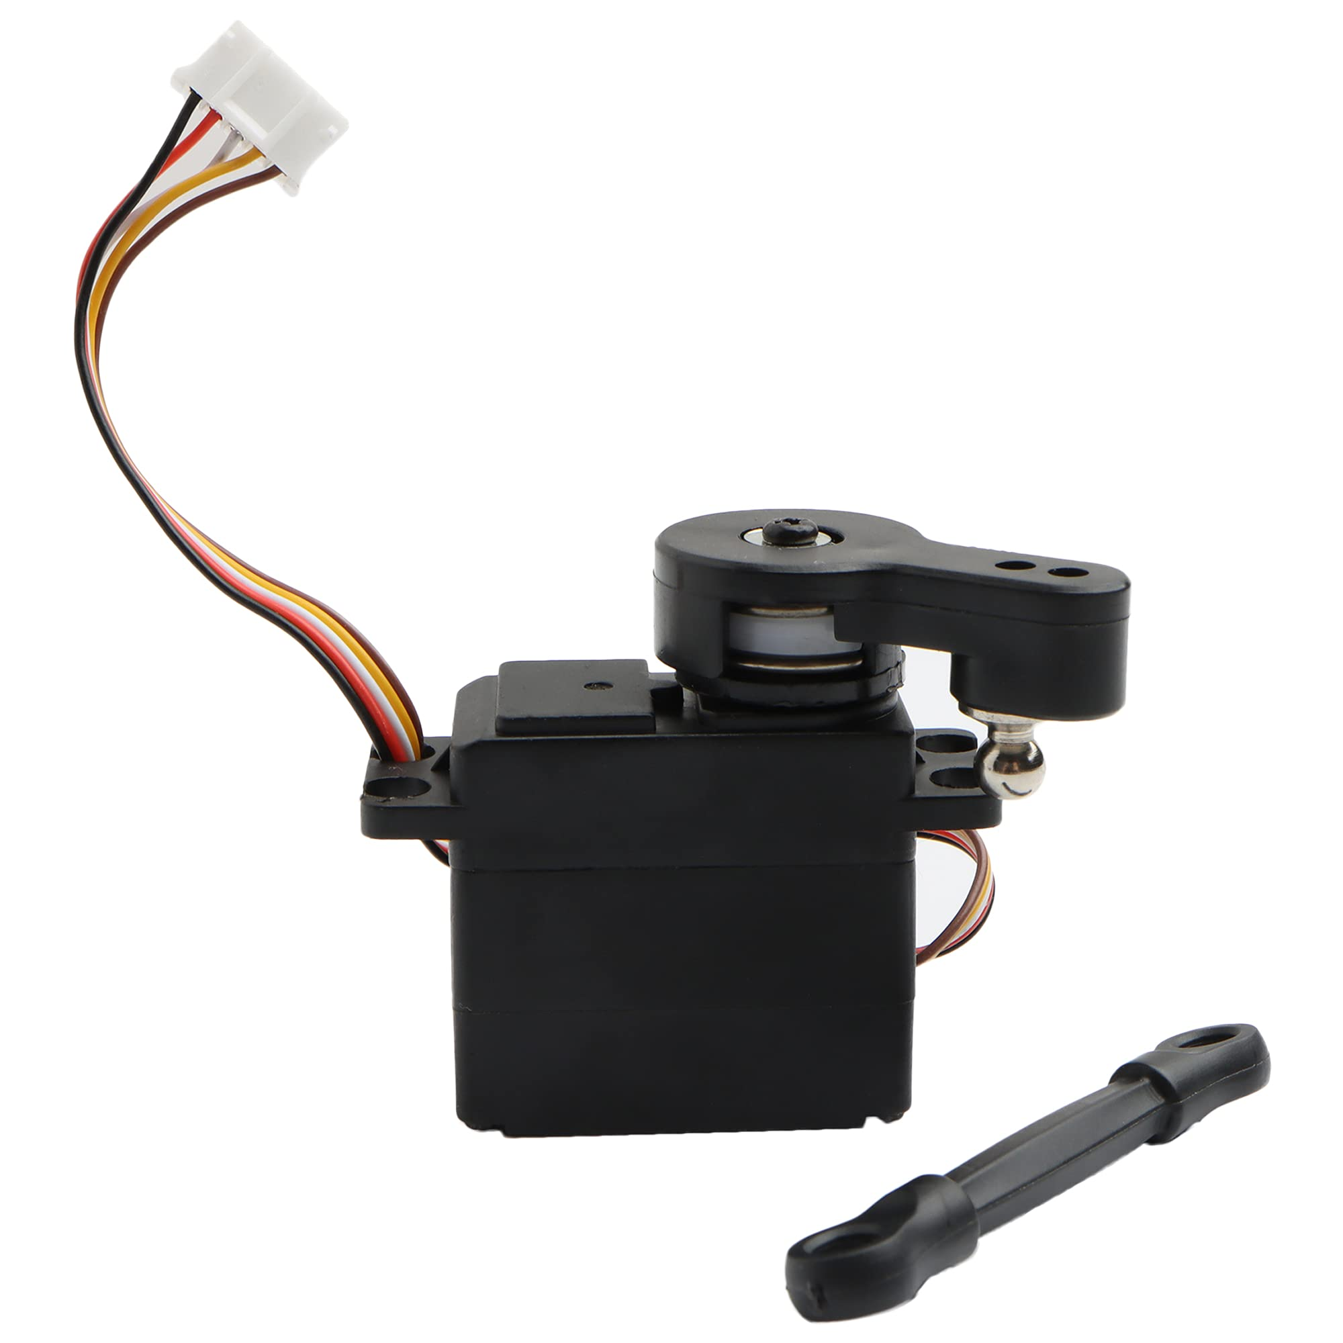
Car Setup cont.
ESC
I2C
PWM
Adafruit PCA9685
Steering Servo
Notes:
Jonathan

Slide 10
Car Calibration
Raspberry Pi outputs PWM signals for the ESC (throttle) and steering servo
Communicates via I2C through an Adafruit PCA9685 servo driver
Calibrate throttle by testing PWM values until desired speed is found for forward, neutral, and reverse operation of main motor
Calibrate steering by testing PWM values for right and left directions on the steering servo
Python configuration stores values to be used while driving
PWM bounds, controller ID, camera settings, etc.
The Donkey Car is now ready for data collection and training steps.
Notes:
Jonathan

Slide 11
Data Collection & Training
PWM values representing Donkey Car’s steering and
throttle used as the “ground truth.”
Time stamp enables correspondence between PWM values and video frames.
Model learns which steering & throttle settings are appropriate based on visual situation.
Data collection: 10 to 15 laps in one direction, 10 to 15 laps in other direction.
Images saved at 20Hz, 160x120px
Track must be on flat surface with no varying light sources.
Notes:
Connor

Slide 12
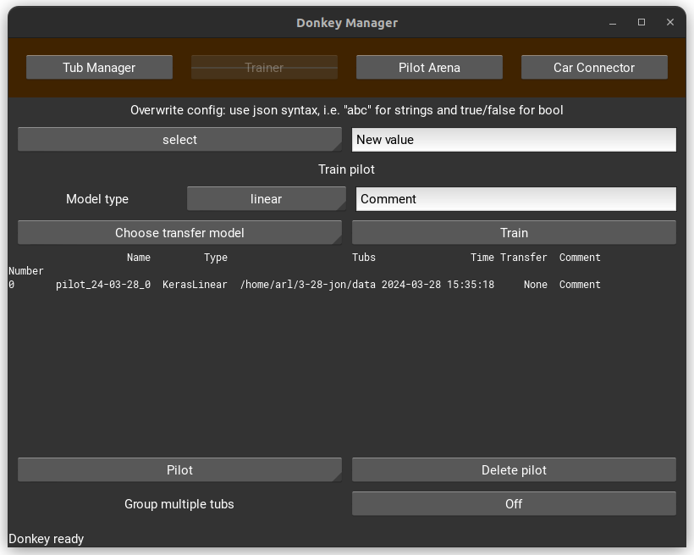
Donkey UI
Trainer: one means of training the autopilot model (alternative to shell)
Tub Manager: enables trimming of unwanted recorded data
Pilot Arena: runs autopilot simulation, compares to steering & throttle behavior from original data recording
Notes:
Connor

Slide 13
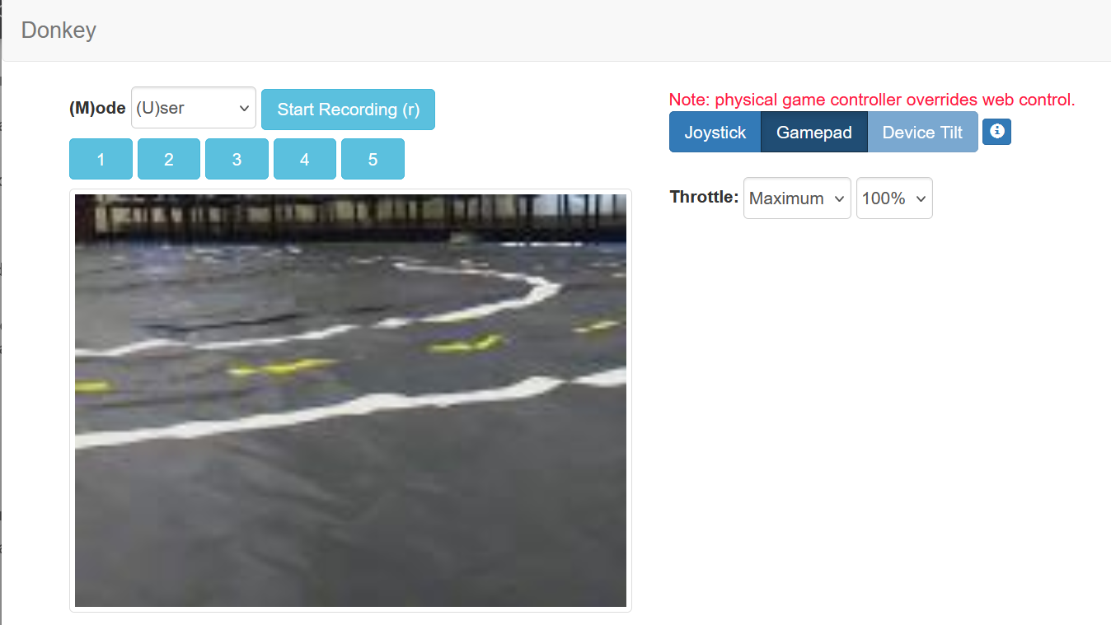
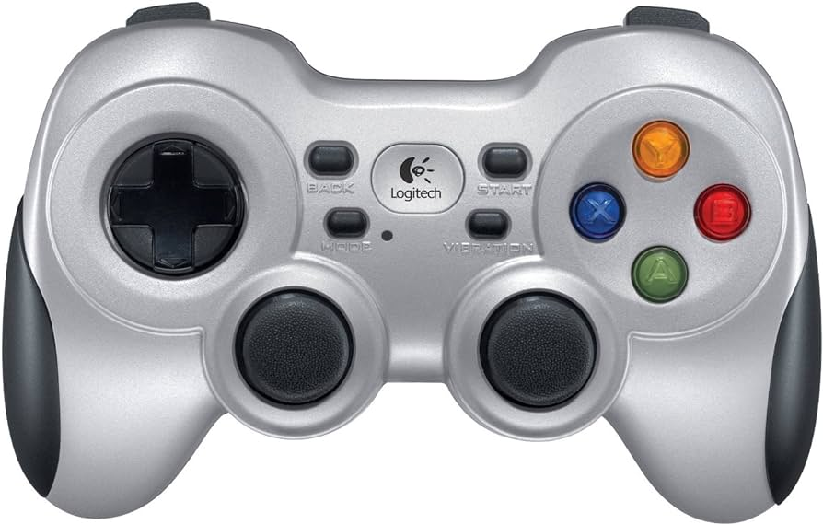
Using the Autopilot
Training data transferred to host PC
Over the network via Linux “rsync” utility or via SD card
Model trained via Donkey GUI or command line
Output in .tflite format (TensorFlow Lite) - optimized for portability and reduced size
Transferred back to Raspberry Pi
Donkey Car drive command invoked with the trained model
Switch between manual and autopilot via controller or web app
Can give autopilot control of steering and throttle, or just steering
Notes:
Connor

Slide 14
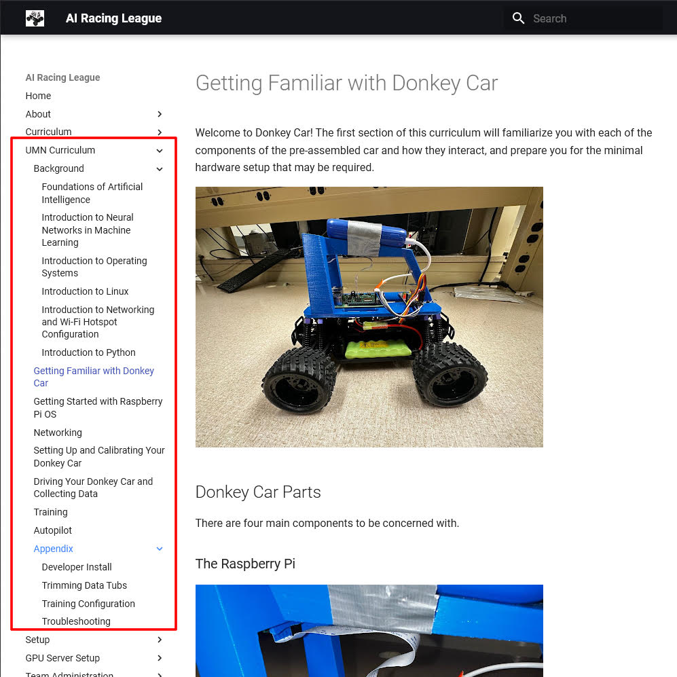
Curriculum
~60 Pages of documentation were written.
Added a tab on the index for the new curriculum.
Keeping all of the information that Dan has developed with the AI Racing League platform.
Merged our modifications to the main branch in GitHub.
The curriculum is available at the AI Racing League website.
Notes:
Cameron

Slide 15
Curriculum cont.
Seven main modules: Background, Donkey Car Hardware, Raspberry Pi OS and Setup, Calibration, Driving and Data Collection, Training, and Autonomous Driving.
Includes detailed steps on troubleshooting and common pitfalls within the processes including covering networking, package control issues, configuration options, and related resources.
Also includes further explanation on terms or actions that would not be clear to those not familiar with Python, AI, Linux/Unix, or command line interfaces.
A prospective student or mentor should be able to follow the curriculum step-by-step and have an autonomously driving Donkey Car and a deeper understanding and interest in AI.
Notes:
Cameron

Slide 16
Acceptance Test
Goal 1: Train a Donkey Car autopilot to autonomously navigate a track
Video of car driving itself
Video of model prediction
Goal 2: Create a comprehensive curriculum guiding high school students to set up a Donkey Car and train an AI autopilot
Accepted pull request
Curriculum is publicly available
Notes:
BRENNAN - To remind you, we had two main goals for our acceptance criteria. Ripped straight from our customer requirements document, the first criteria was the car can complete several laps within track limits fully autonomously. The second was to create documentation that must be thorough enough to where Dan McCreary deems it to be an acceptable technical level for high school students to follow what we did and overcome any potential issues. [Next]

Slide 17
Goal One Acceptance
Self
Driving Car
Model
Prediction
Notes:
BRENNAN - For acceptance of the first goal, we have two videos. The one on the left shows the car completing several laps on the track autonomously and mostly within the track limits. Due to some limitations with the existing Donkey code, we still deemed the car successful at self driving even with it leaving the track bounds occasionally. Interestingly, it almost seemed like it corrected itself over time where the car would miss an especially sharp turn badly on the first lap, but less with each subsequent lap. The one on the right shows a screen recording of the Donkey UI. The green line you see here is the user input during that frame where the length is the throttle and the direction is the steering servo direction, and the blue line is the prediction the model is making for throttle and steering requirements, given the visual data.

Slide 18
Goal Two Acceptance
Dan pushed our changes to the live site!
Our 60 page document was converted to markdown
GitHub pull request was made, Dan accepted and pushed to the public website
AI Racing League Site
https://www.coderdojotc.org/ai-racing-league/
Notes:
BRENNAN - For goal two, we started by converting our curriculum to markdown to be uploaded to the site. In a private branch on the AI Racing League repository, we made a pull request which Dan has since accepted and the curriculum is now live on the site!

Slide 19
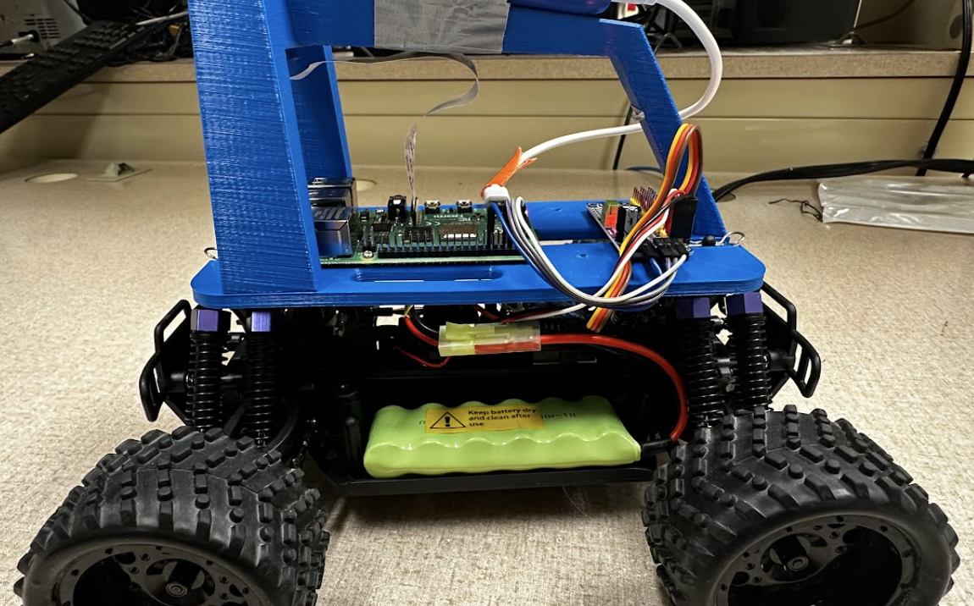
Thanks!
AI Racing - Senior Design Team
Special Thanks:
Dan McCreary
Prof. Sachin Sapatnekar
Notes:
BRENNAN - Thank you for coming to our product launch. We wanted to give a special thanks to our project advisors, Dan and Professor Sachin for helping us out a bunch this semester and providing us with all of the materials to make this happen. Thank you!

